Slide 1
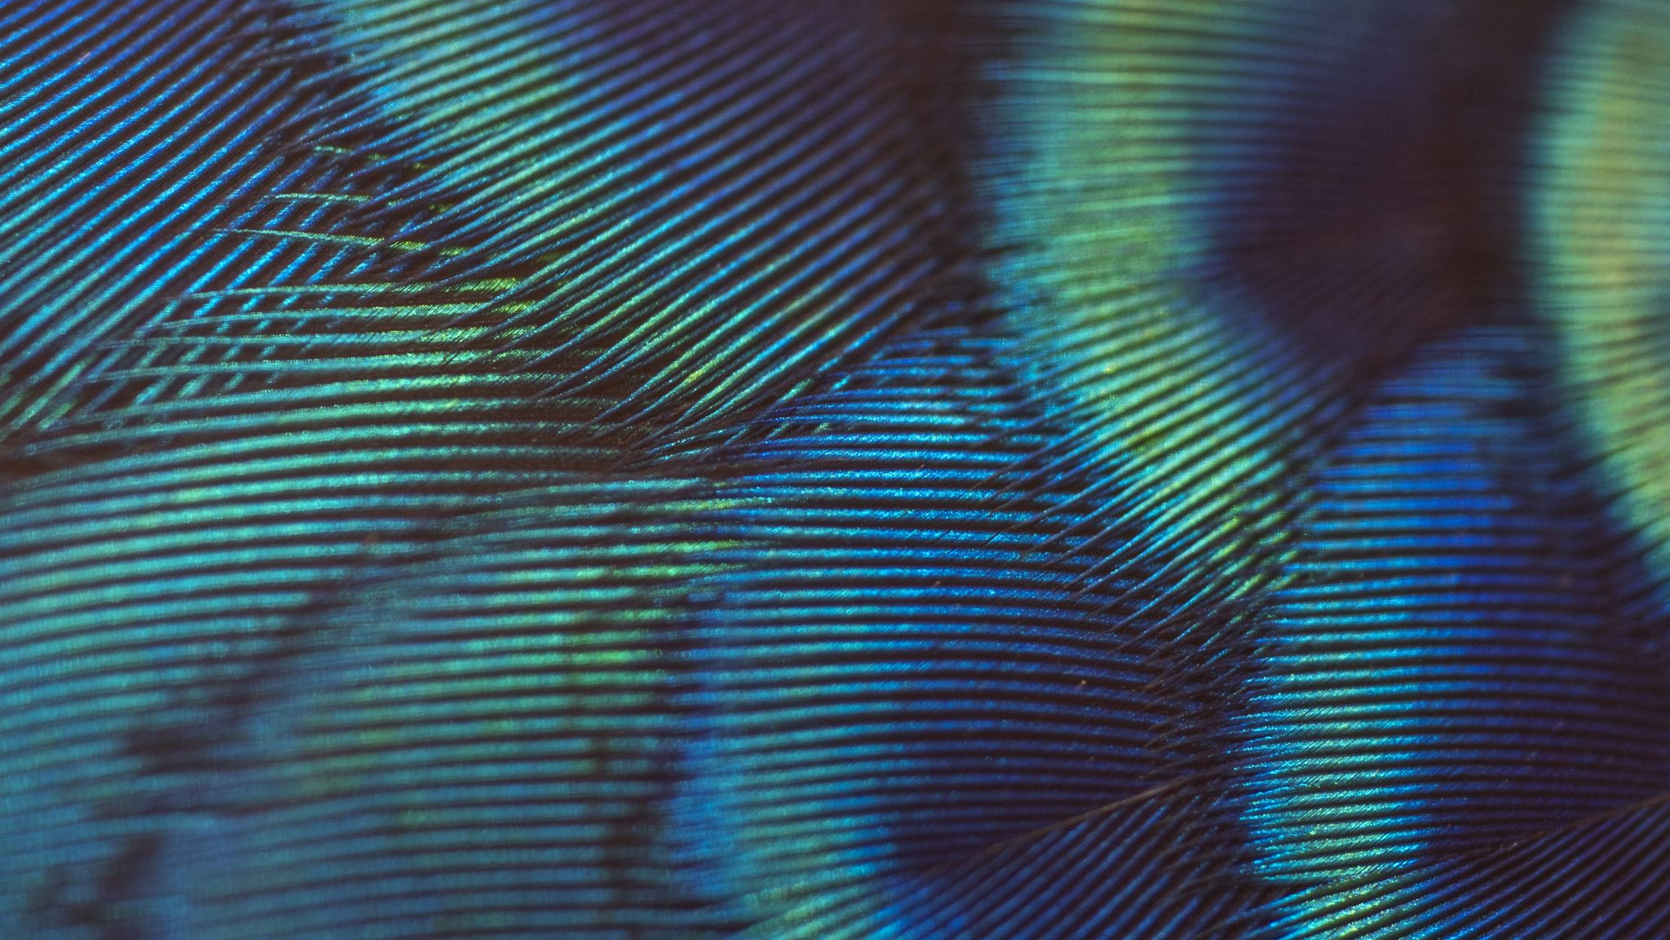
Composition: Rhythm, Repetition, Balance
Aubrie Pitts

Slide 2

What Is Composition
composition refers to the arrangement of elements used in the piece you have created, paying attention to what will be photographed, how it is placed in relationship to other objects in the image, and how well the subject matter is expressed. Balance, Rhythm, and Repetition are just some of the aspects of composition

Slide 3
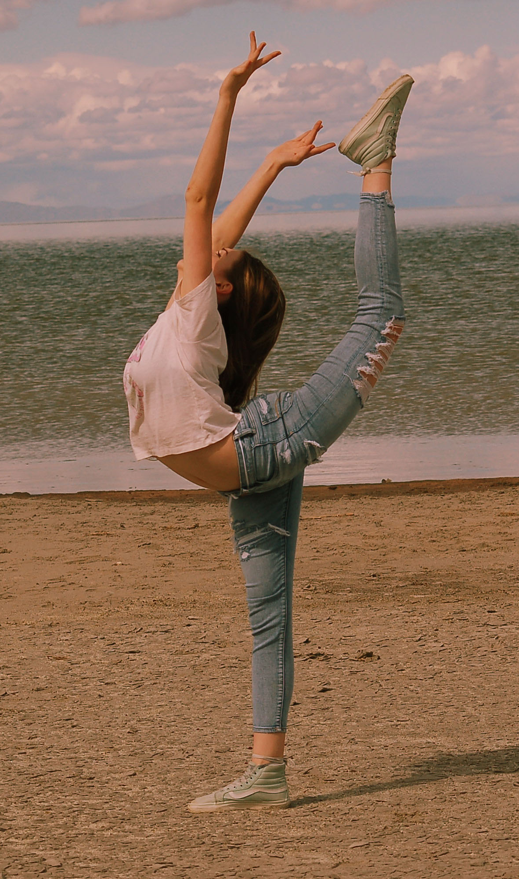
Balance
Unbalanced photos mean viewers will feel that something is wrong.
Balance results from looking at an image and feeling that it is evenly 'weighted' on all sides.
symmetrical and asymmetrical, evenly distributed
The 'rule of thirds' is one example of a balanced, asymmetrical compositional tool.

Slide 4
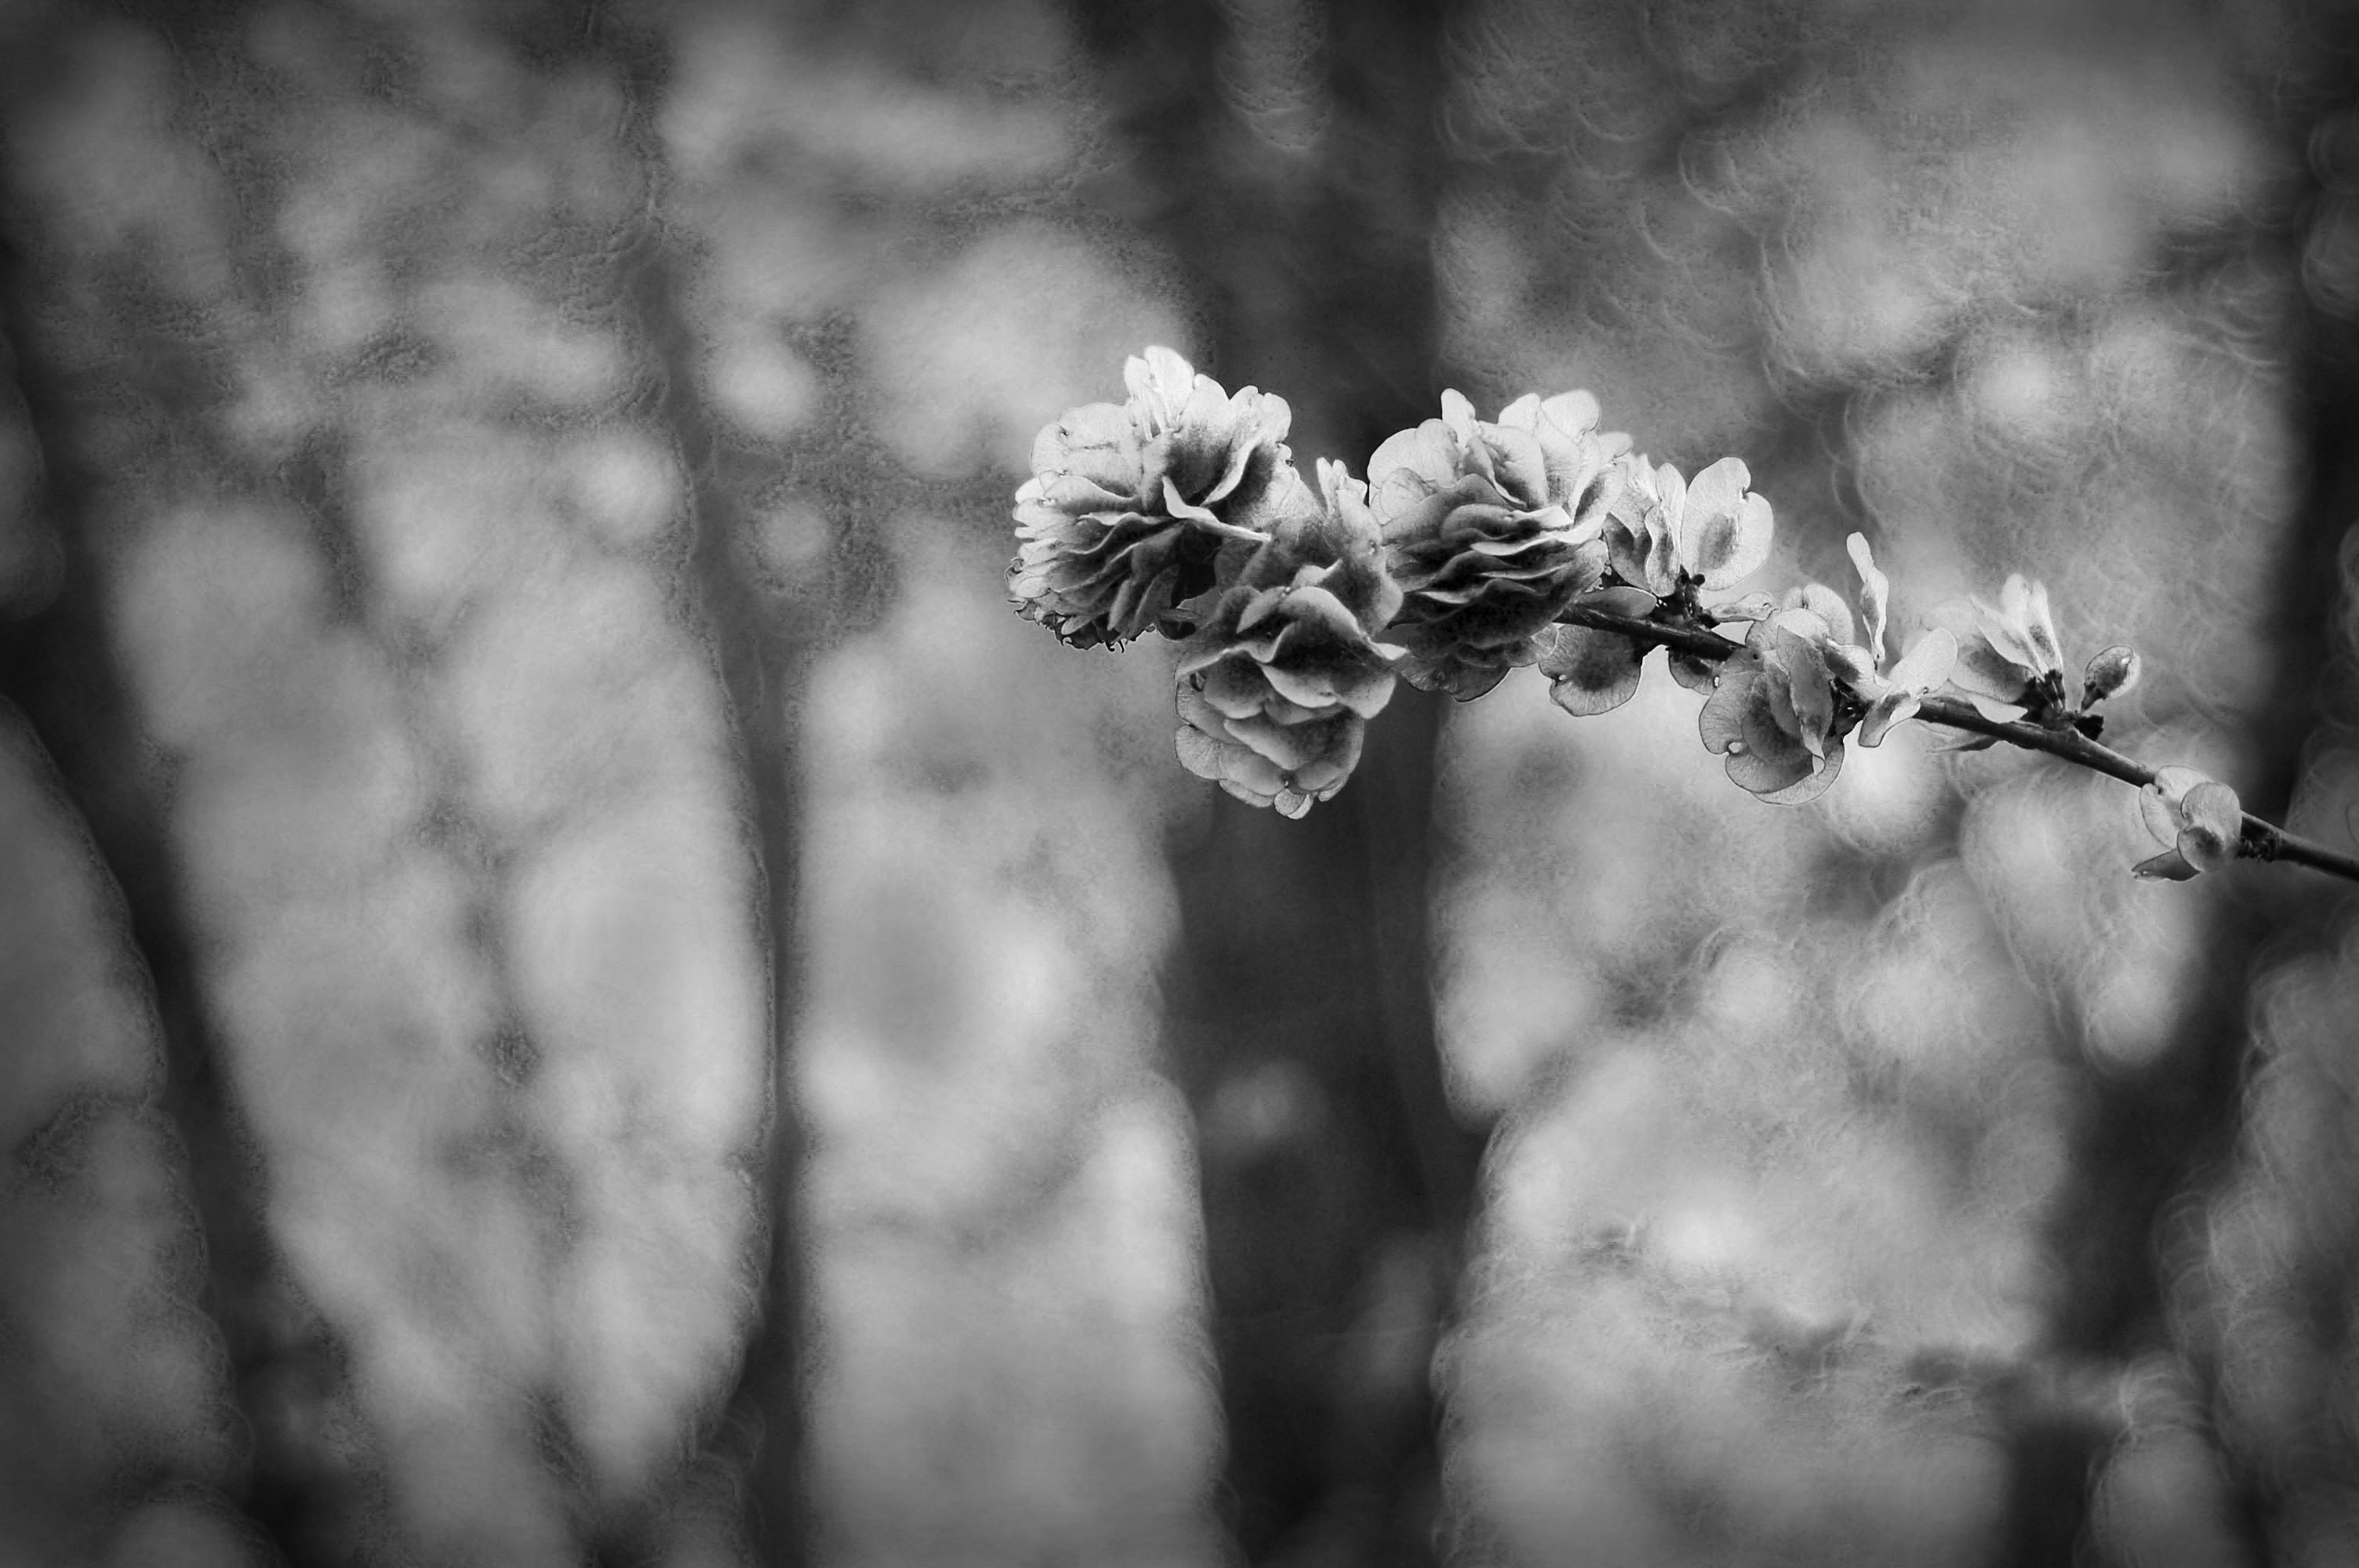
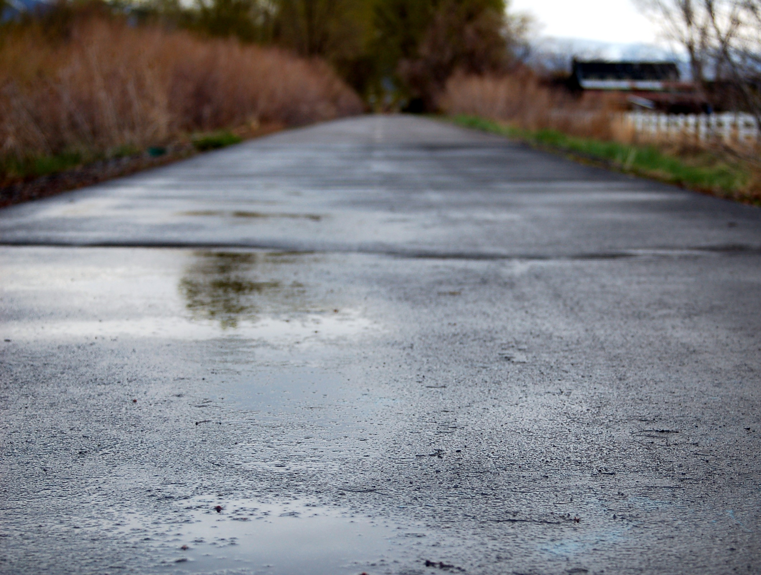
Types of Balance
Asymmetrical Balance- Not identical on both sides, but feels evenly weighted (rule of thirds)
Symmetrical Balance- Evenly weighted on both sides (almost identical) left and right, or top and bottom.

Slide 5
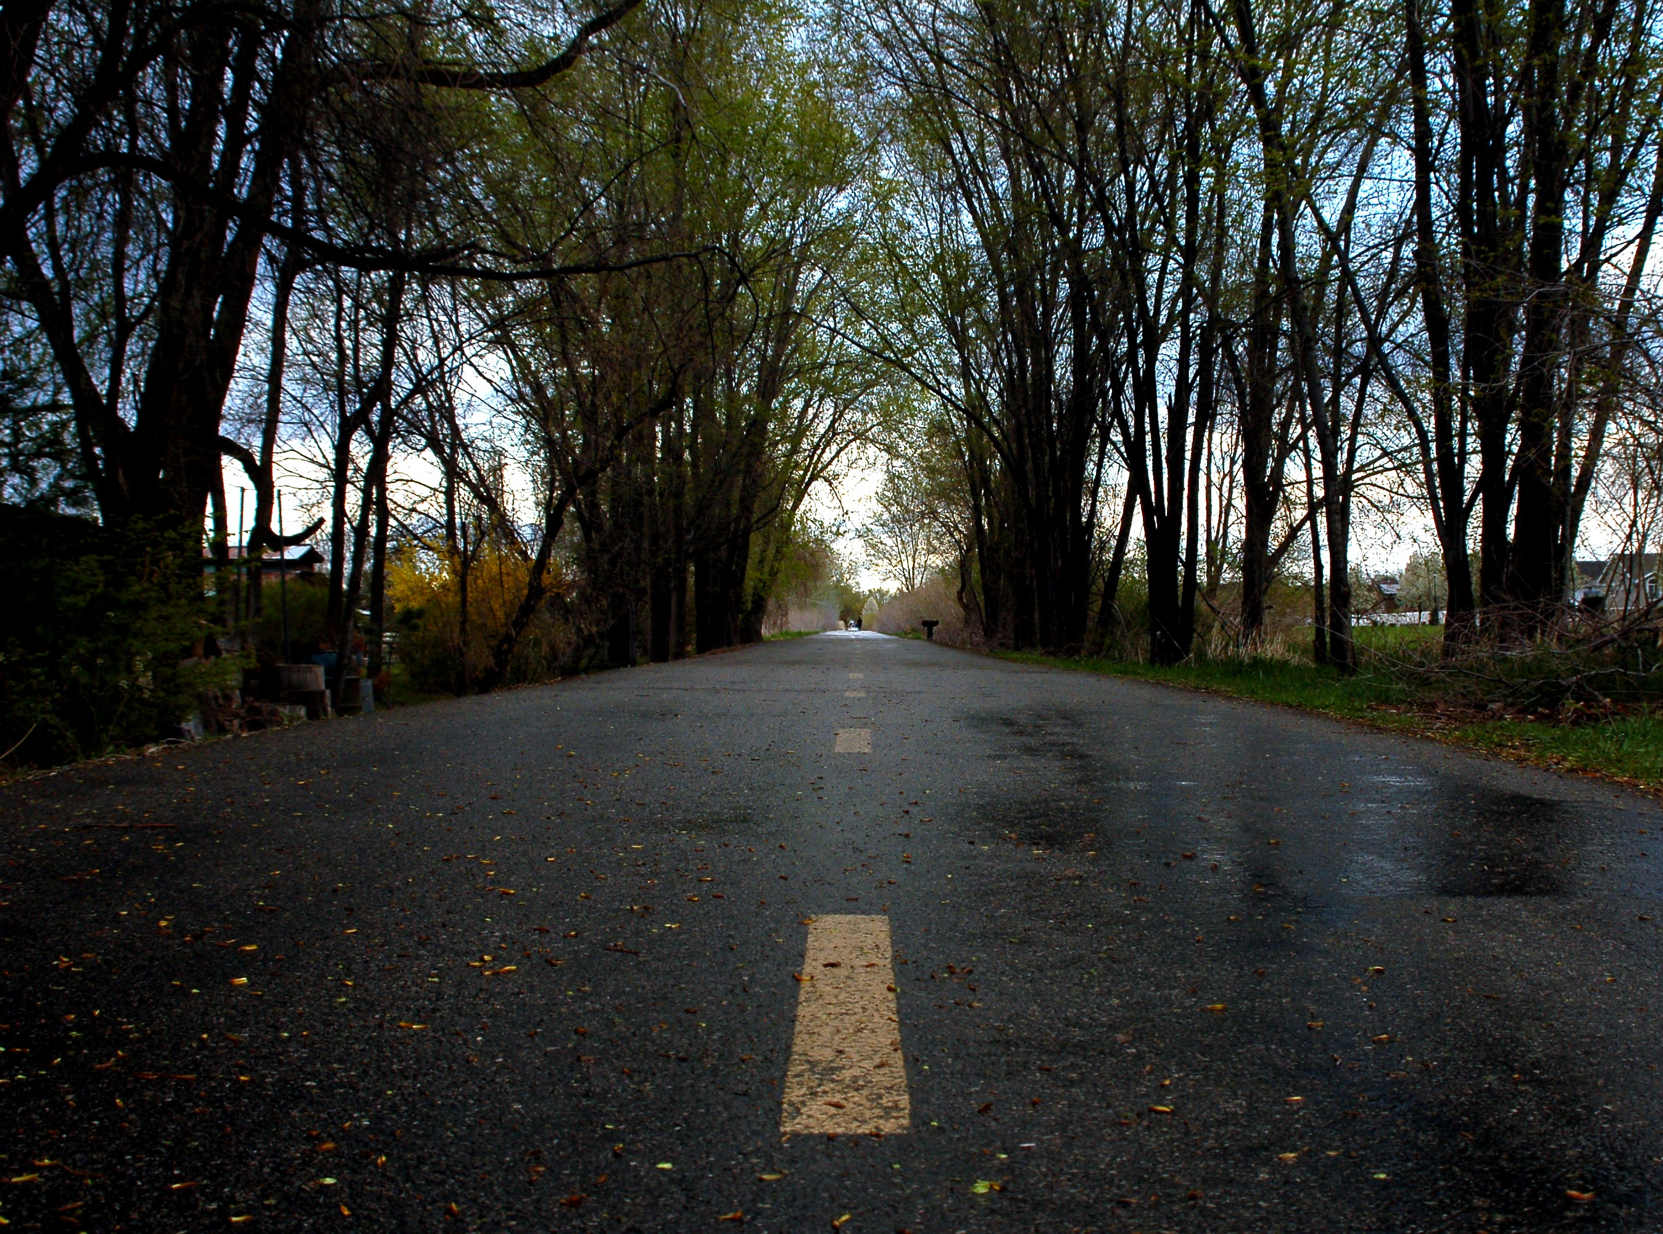
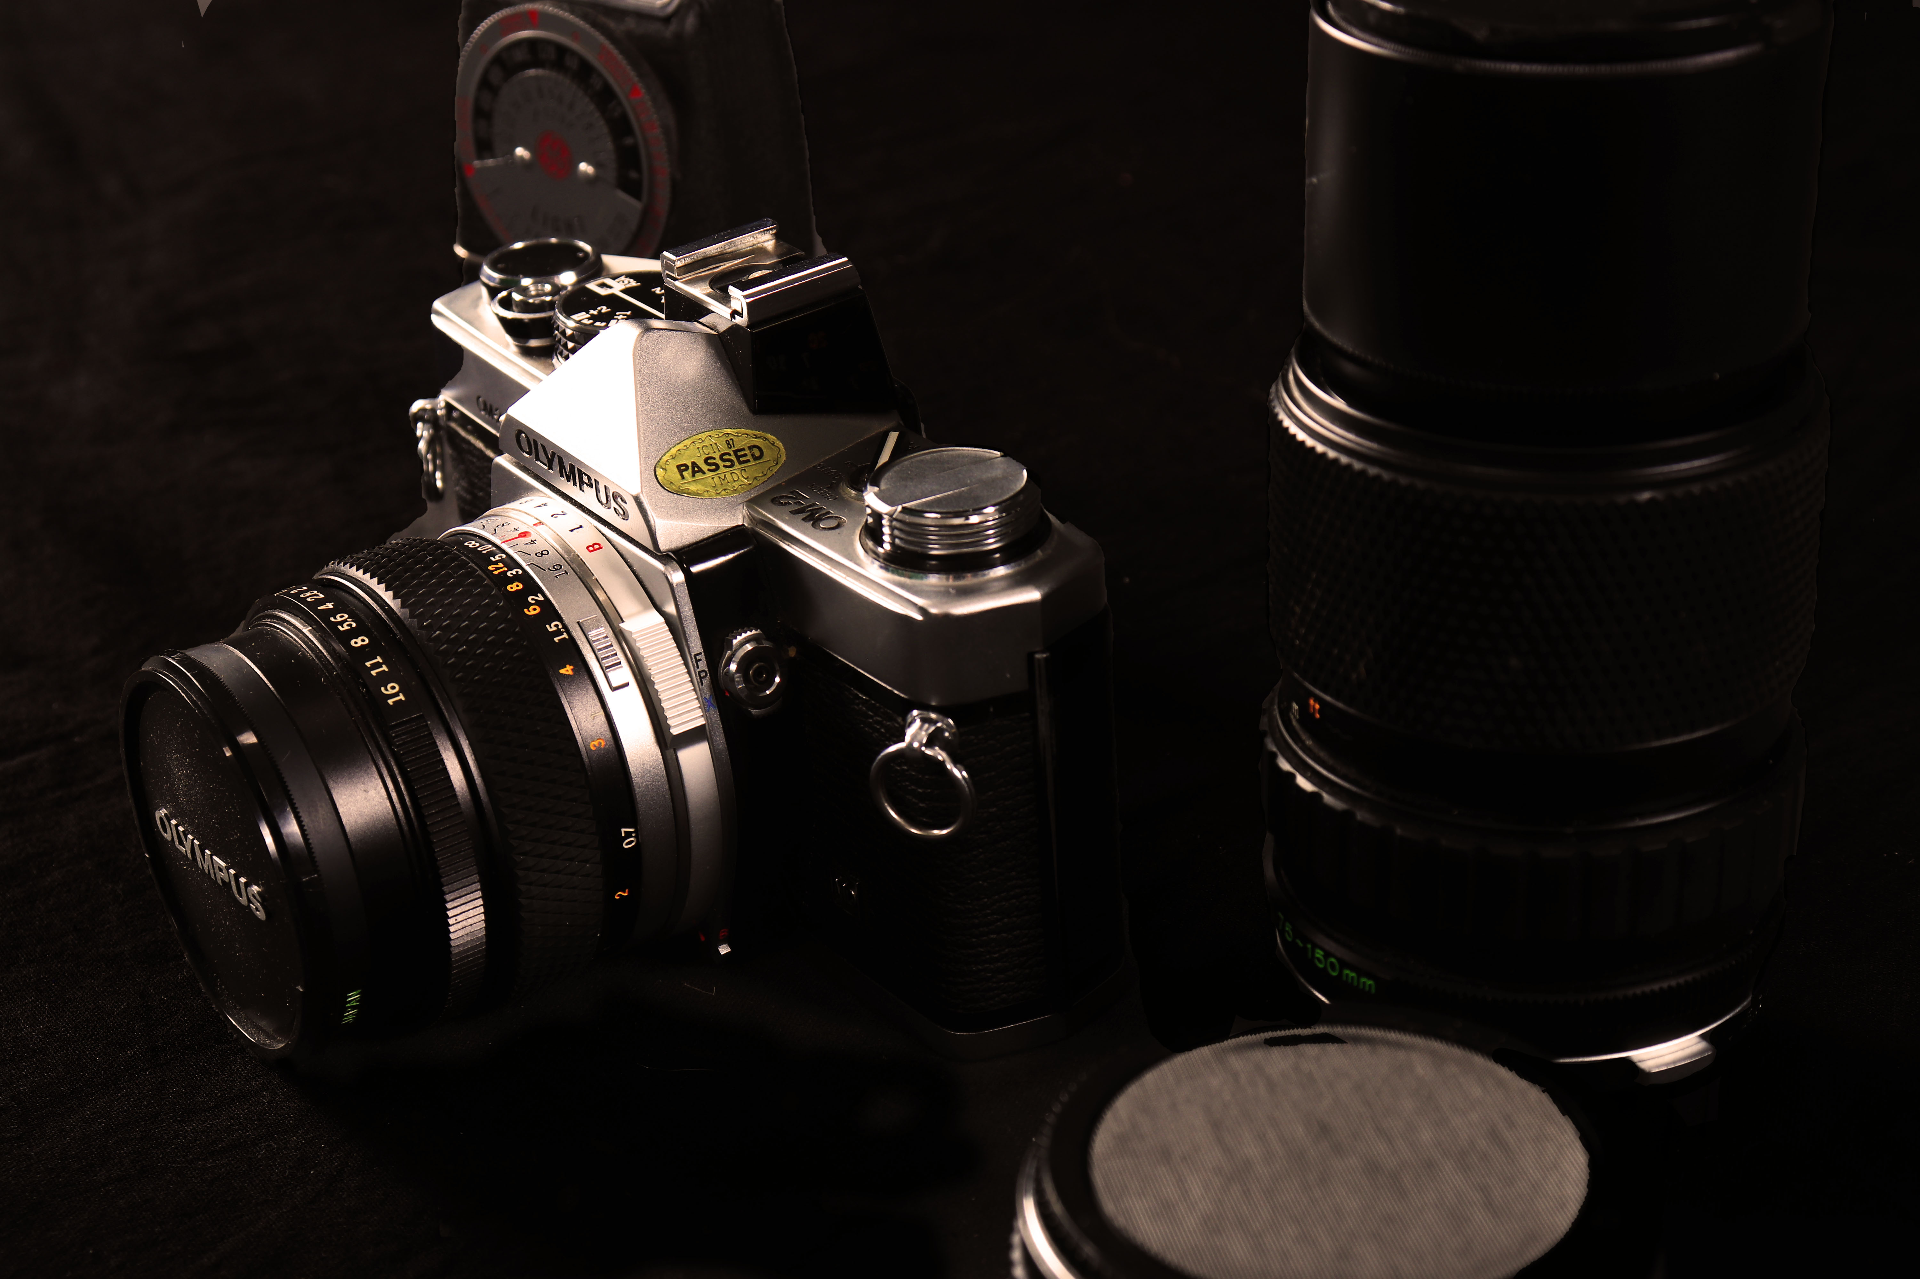

More Examples of Balance

Slide 6
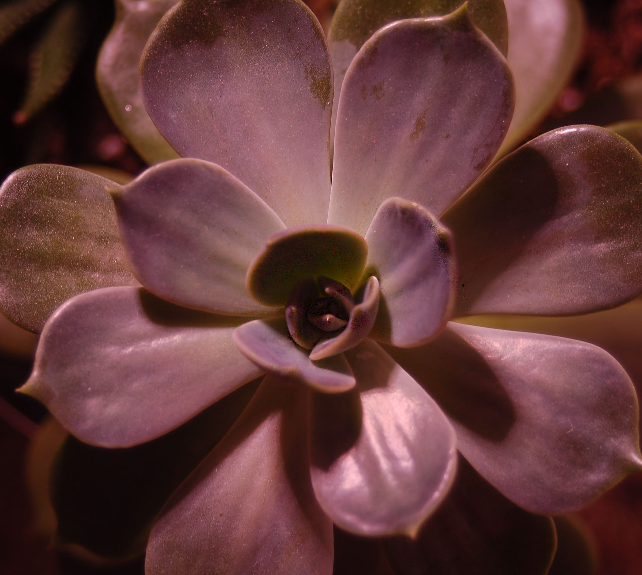
Rhythm
Correlates to repetition
Intervals between repeated pattern
Several types of rhythm: uniform rhythm, or a more flowing rhythm
Creates a mood for a photo, and helps balance.

Slide 7
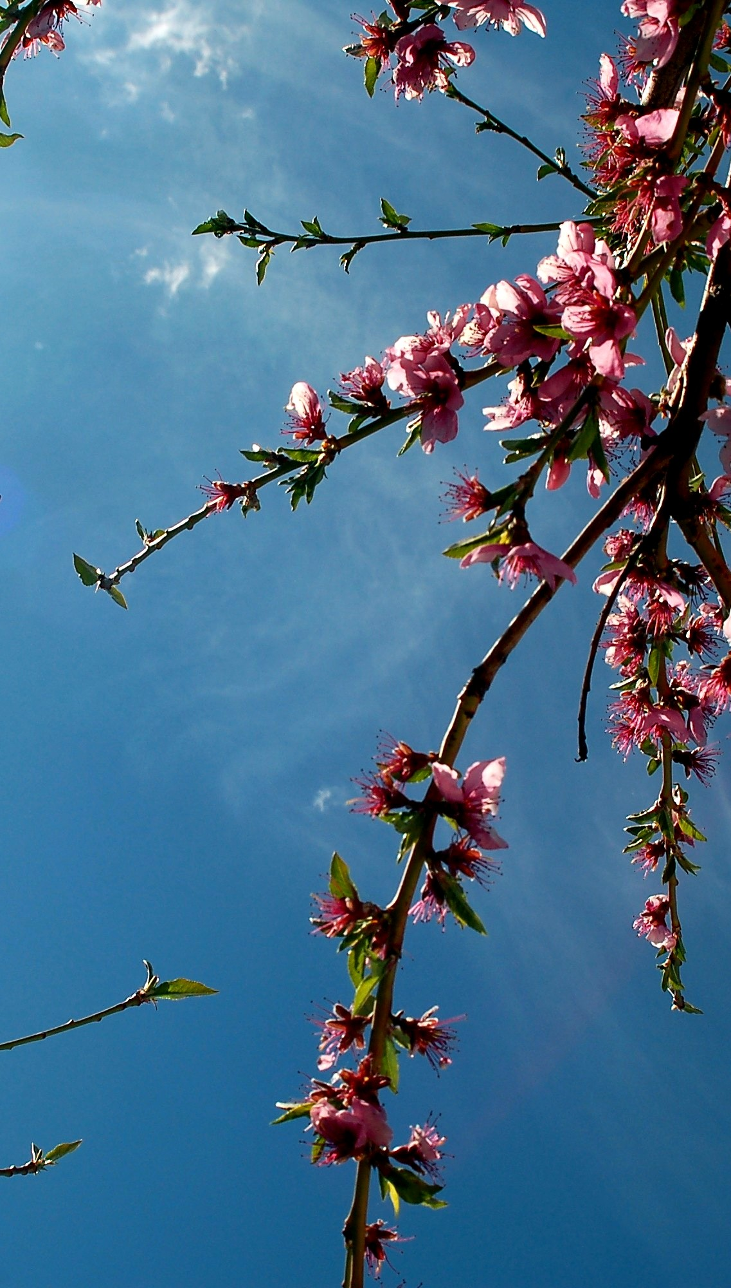
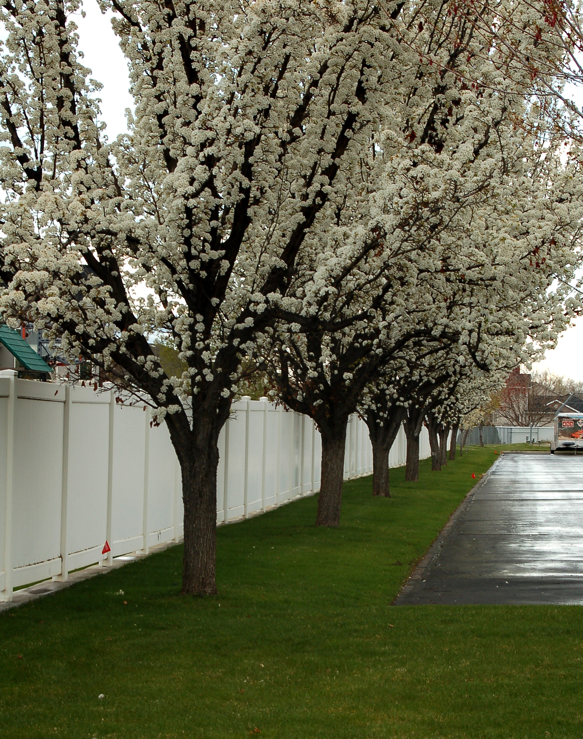
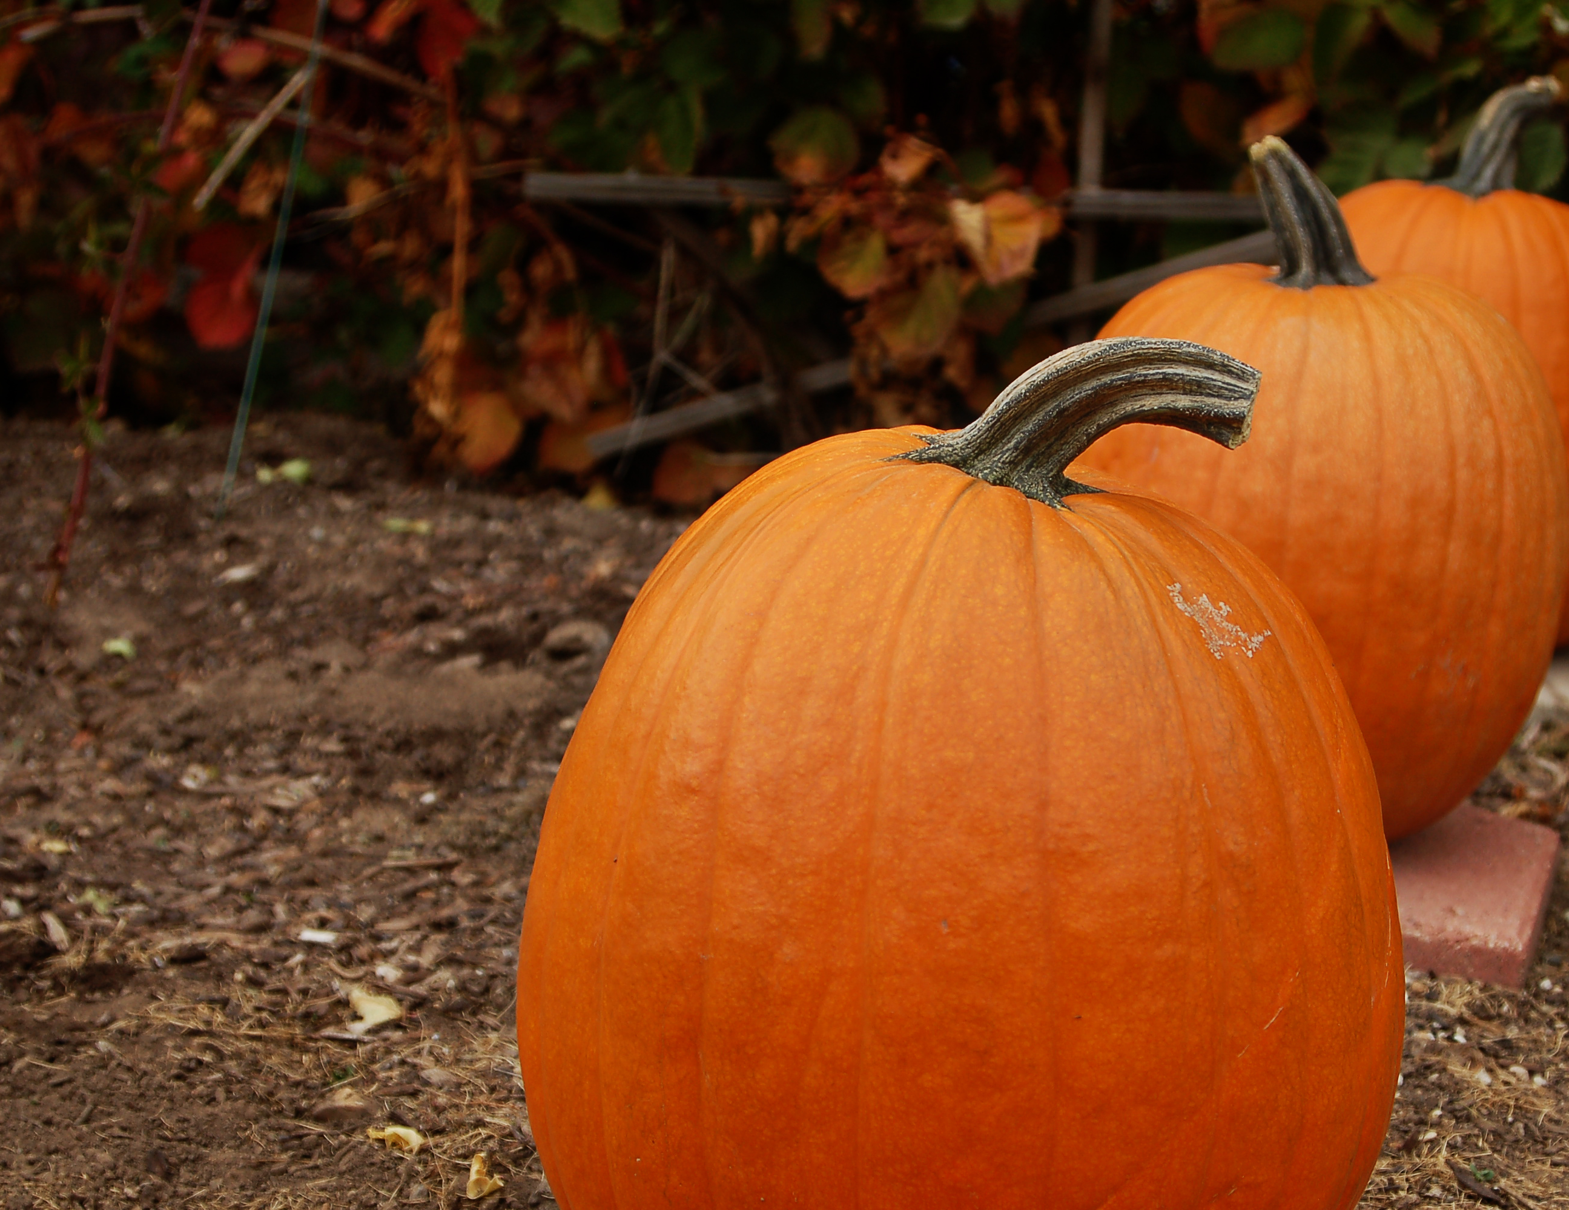
More Examples of Rhythm

Slide 8
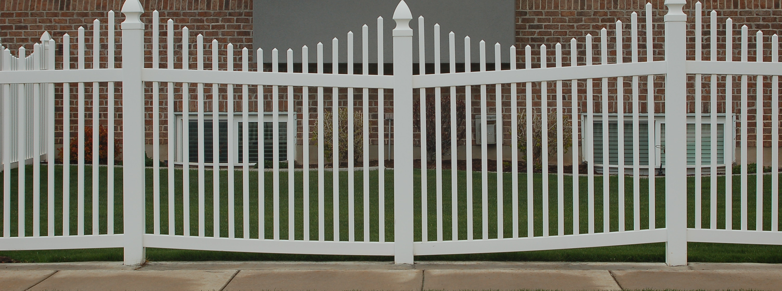
Repetition
Repeating elements in an image
comprises shapes, colors, or lines.
Repetition involves using similar things over and over again
our eyes pick out the patterns and follow them.

Slide 9
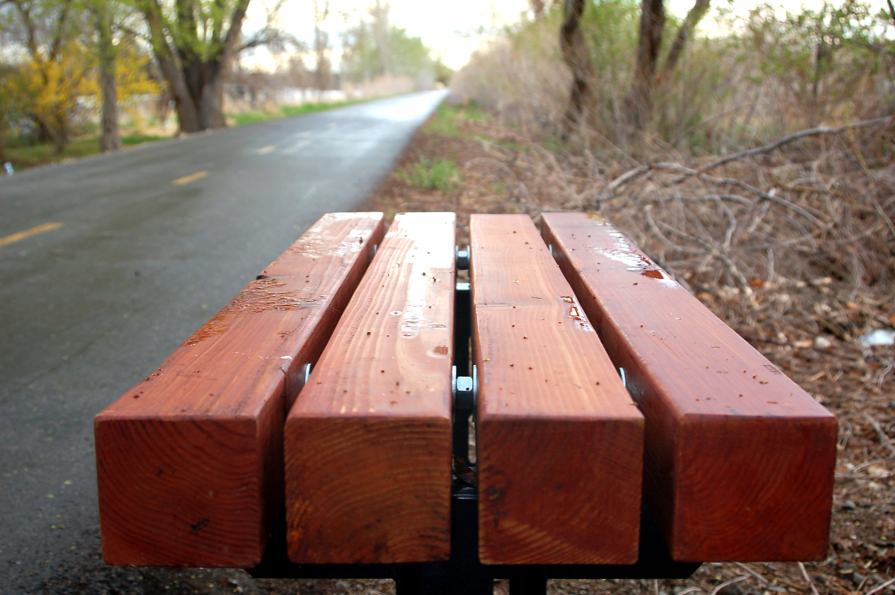
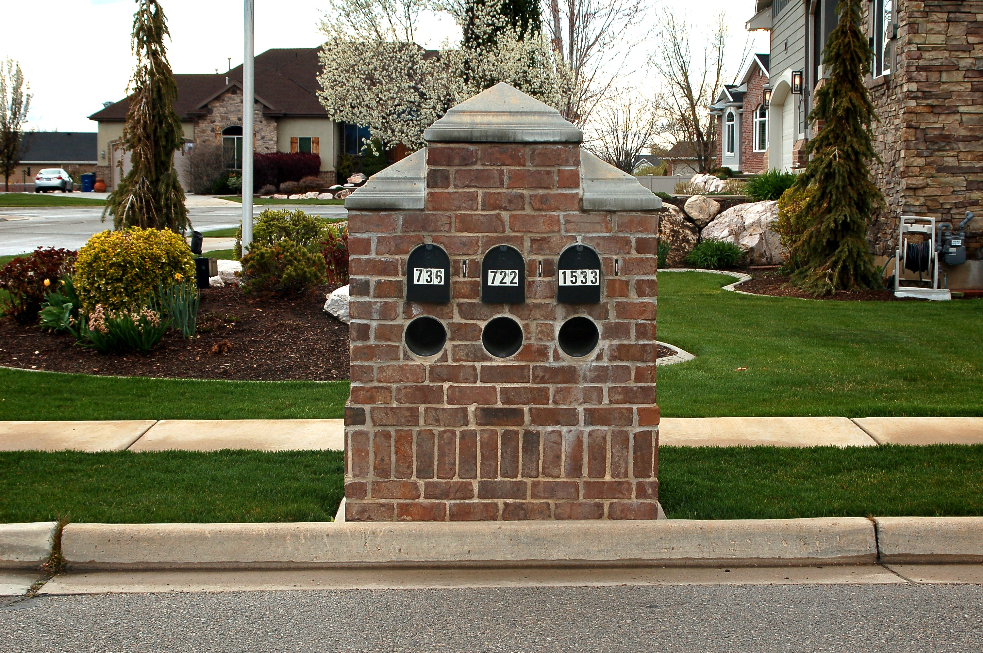
More Examples of Repetition

